Slide 1

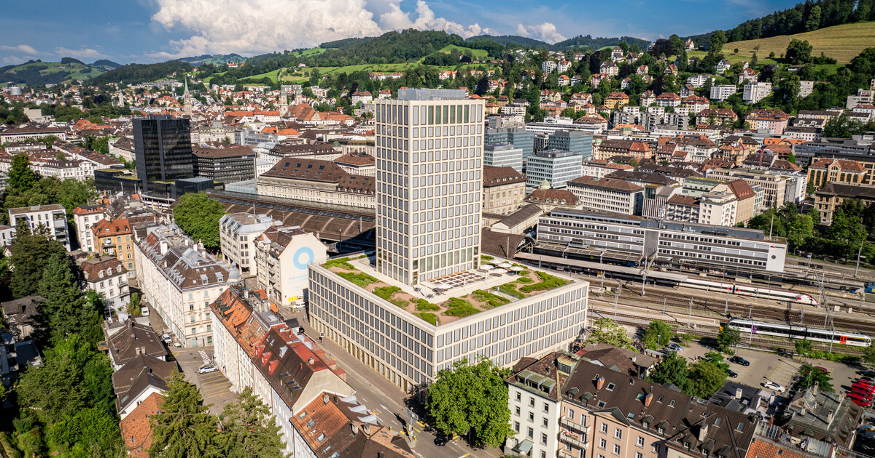
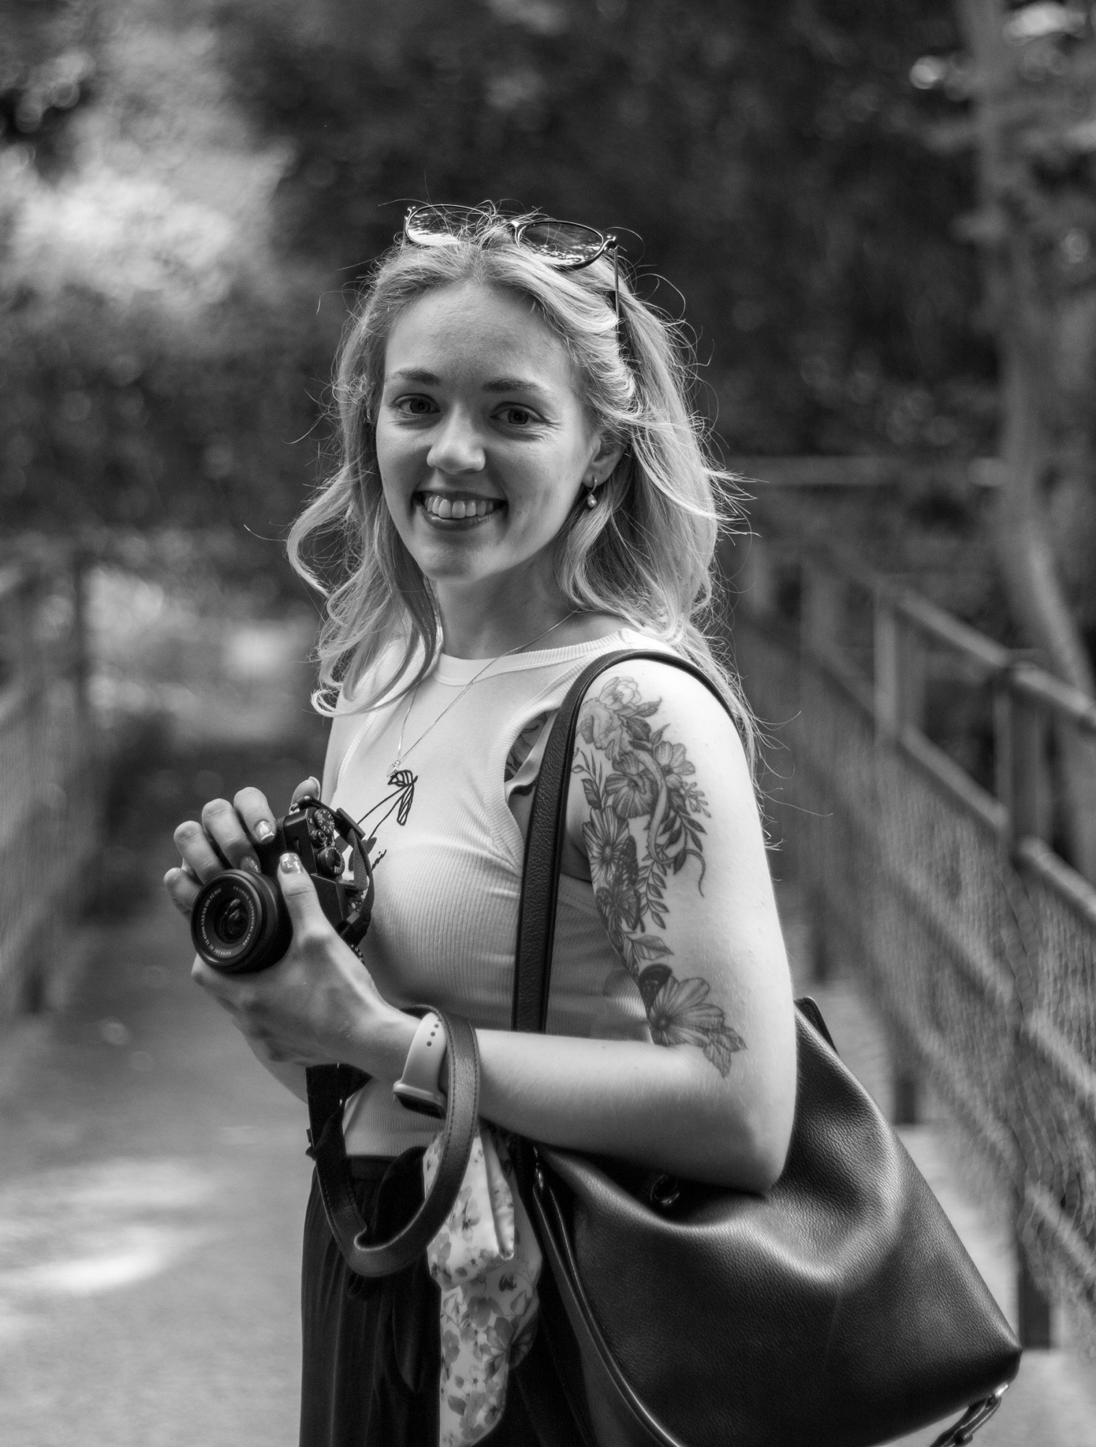
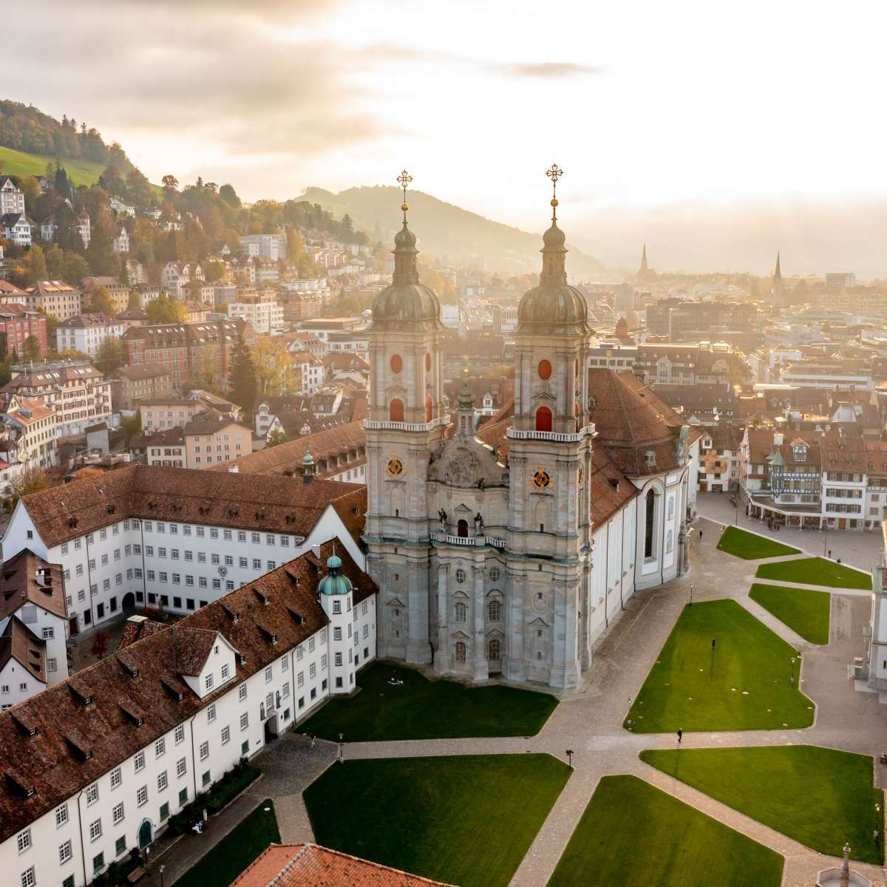



Tanisha India Graf
University: Eastern Switzerland University of Applied Sciences
Study program: Physiotherapy
Year of study: 3rd semester
City: St. Gallen, Switzerland
Motto for life: Discomfort is part of growth.
Hobbies: Knitting, photography, sports (hiking, weight lifting, etc.) and baking
Your expectations from the summer school:
I want to learn how to make the world more sustainable.
Location where I study,
and where I live
Karlsruhe
31 August to 11 September 2026

